Slide 1
MATTER & THE PARTICLE MODEL
MATTER
THE PARTICLE MODEL
PHASES OF MATTER
MOLECULES & ATOMS

Slide 2
MATTER & THE PARTICLE MODEL
Matter is anything that has volume & mass (takes up space)
The particle model
Matter is made up of particles that are extremely small
These particles are in constant movement
When temperature increases, the movement of these particles increases
The particles are held together by forces of attraction

Slide 3
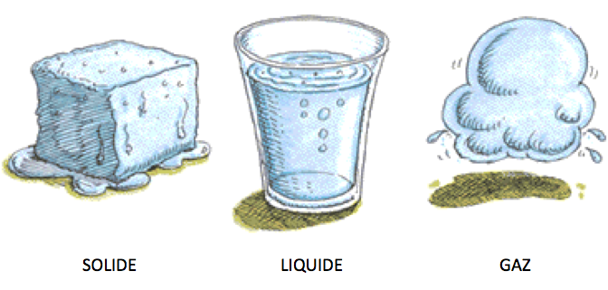
PHASES OF MATTER

Slide 4
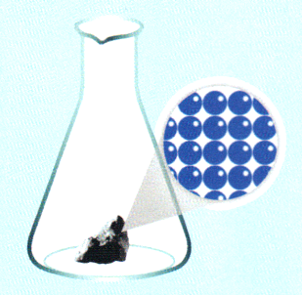
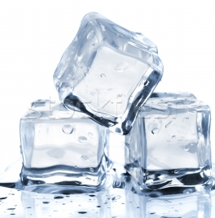
PHASES OF MATTER
SOLIDS
Solids are composed of particles held together by invisible links.
These ties are so strong that the particles can not move freely.
The particles can only vibrate. Their particles are held together.
Solids have a definite shape and occupy a measurable volume

Slide 5
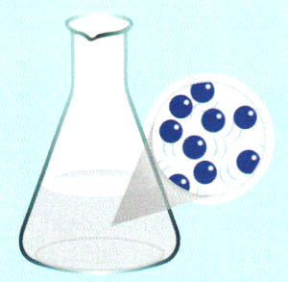
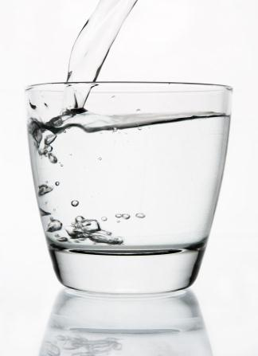
PHASES OF MATTER
LIQUIDS
The links which connect the liquid particles are lower than those linking the solid particles. The particles are slightly free and can move slowly.
Liquid will not retain their shape. It has a definite volume.
A liquid takes the shape of the container in which it is placed

Slide 6
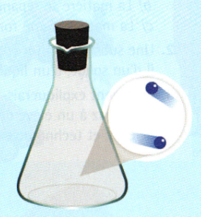
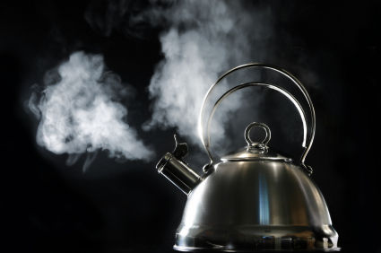
PHASES OF MATTER
GAS
The links between the particles of gas are even lower than those linking the particles of a liquid. Particles can move much more freely than those of solids and liquids - There are large gaps between the particles
As their particles can move very freely, gas particles can circulate in all directions. No definite shape or volume
A gas spreads to fill the space of a container or a part.

Slide 7
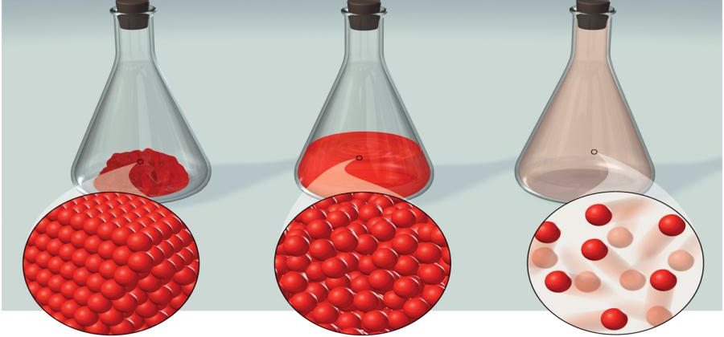
PHASES OF MATTER
SOLIDS
Particles do not move freely
Vibration only
LIQUID
Particles small movements
Move slowly
GAS
Particles FREE movements
Move fast

Slide 8
MOLECULES & ATOMS
An atom is the smallest particle in matter. It cannot be divided by chemical means
A molecule is a group of two or more atoms held together by chemical bonds

Slide 9
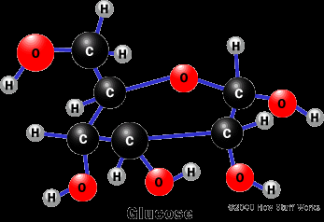
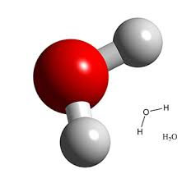
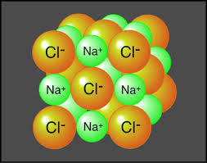
MOLECULES & ATOMS
A molecule of GLUCOSE (sugar) $C_{6}$ $H_{12}$ $O_{6}$
A molecule of WATER $H_{2}O$
A molecule of SALT ${NaCl}_{}$

